Slide 1
Grammar and Vocabulary for RSE
Упражнения для активизации и обобщения знаний учащихся при подготовке к ГИА
Выполнили
Анисимова А. Н. – преподаватель иностранного языка
Ващенко Е. Л. - преподаватель иностранного языка
СПб ГБ ПОУ «Малоохтинский колледж»

Slide 2
Grammar
Keys: 1) it 2) it 3) there 4) there 5) there 6) it 7) there 8) there 9) It
10) it 11) It 12) It 13) there 14) it 15) there

Slide 3
Grammar Exercises
Read the text below and look carefully at each line. In most of the lines there is one word that does not fit grammatically. Write this one word on the right. If a line is correct, put a tick√. The first two lines are given as an example.
The Greenhouse Effect
0 This week in Kyoto in Japan the latest conference
00 on the environment is being taking place. The whole
1 world is today watching to see what happens
2 as delegates from more than 165 countries discuss
3 what measures need not to be taken to reduce the
4 fumes that is create the Greenhouse Effect. They
5 do not hope to agree on ways of reducing the amount
6 of carbon dioxide and other gases that we
7 send into the atmosphere. These gases to act the way a
8 greenhouse does and, as a result, the Earth is
9 be getting hotter and hotter all the time. The
10 temperature it is rising gradually and
11 in 100 years’ time the Earth will be hotter by about 4°C.
12 The problem is be getting worse as more cars
13 are make an appearance on our already crowded roads.
14 The solution in Kyoto is depends on what the United States,
15 one of the most powerful nation on Earth, feels is in its interests.
√
being
today
√
not
is
not
√
to
√
be
it
√
be
are
Is
√

Slide 4
Wordbuilding
Prefixes
Keys
Across: 1. il- 2. trans- 5. under- 7. pro- 8. in- 10. over- 11. anti- 13. mis-
Down: 1. inter- 3. super- 4. co- 5. un- 6. dis- 8. ir- 9. post- 12. im-

Slide 5
Wordbuilding
Suffixes
These nouns are formed with the suffix –ion. Complete the chart with the original verbs.
Noun | Verb
1. Decision
2. Qualification
3. Addition
4. Accusation
5. Flotation
6. Expansion
7. Rendition
8. Confession
9. Opposition
10. Occupation
11. Collision
decide
qualify
add
accuse
float
expand
render
confess
oppose
occupy
collide

Slide 6
Linking words and phrases
Keys
11. A. Although 12. B. the fact that 13. D. the heat 14. C. However, 15. B. however

Slide 7
Phrasal Verbs
Keys
16. C. along 17. D. back 18. A. away 19. C. into 20. D. over

Slide 8
Use of English
Keys
21. B. qualifications 22. A. attraction 23. D. accusations 24. B. competition
25. A. cancellation

Slide 9
Use of English
Keys
21. C. circumstances 22. D. investment 23. C. carelessness 24. A. retirement
25. C. strength

Slide 10
Vocabulary
Keys
1. friendly 2. unfriendly 3. friendship 4. close 5. made 6. user-friendly

Slide 11
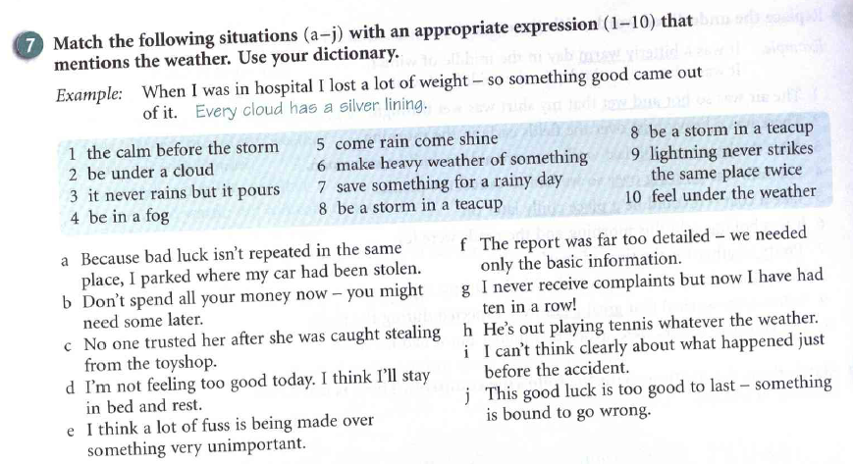
Vocabulary
Keys
1. j. 2. c 3. g 4. i 5. h 6. f 7. b 8. e 9. a 10. d.

Slide 12

Источник
Учебное пособие
Luke Prodromou Grammar and Vocabulary for First Certificate.- Pearson Education Limited, 1999

