Slide 1
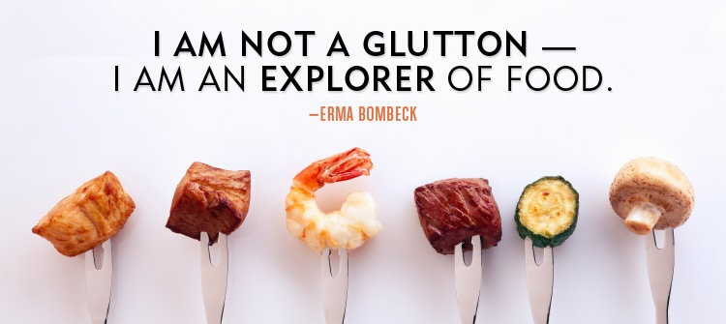
A glutton-обжора
An explorer-исследователь
And what are you?)
Выполнила: учитель английского языка Ващенко Е. Л.
ГБ ПОУ «Малоохтинский колледж» г. Санкт-Петербург

Slide 2
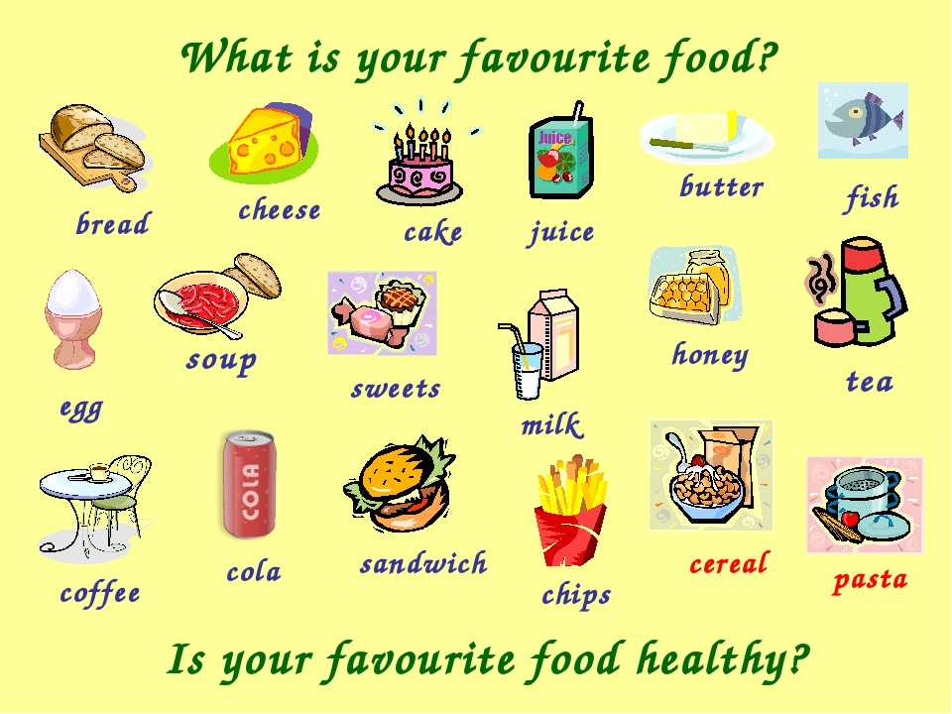

Slide 3
Healthy or Unhealthy
Healthy Food
Fruit
Vegetables
Dairy
Eggs
Grains
Meat
Junk Food
Sandwich
Cake
Sweets
Cola
Hamburger
Chips

Slide 4
Guess the Riddles What food is it?
Riddle 1
Which dog has no tail?

Slide 5
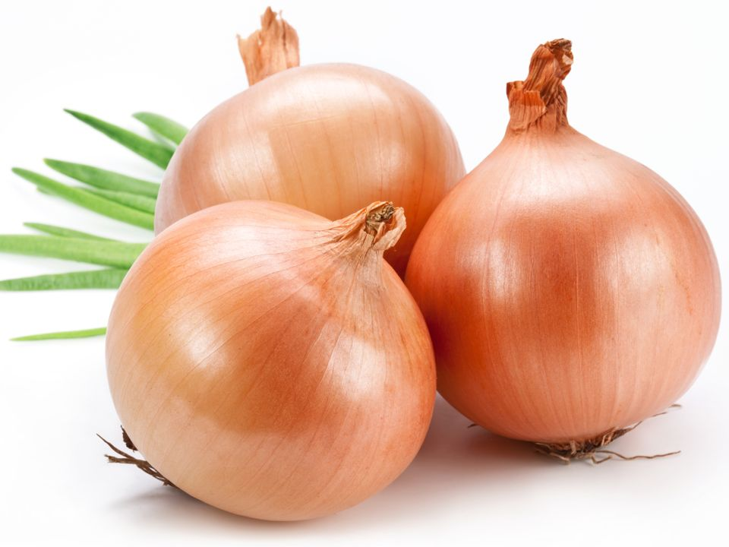
Riddle 2
Little old uncle, dressed in brown.
Take off his coat, how the tears run down!

Slide 6
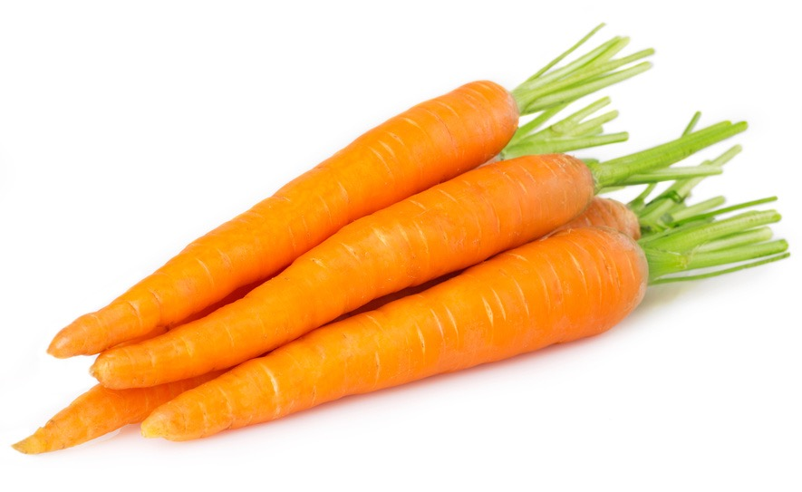
Riddle 3
This long orange lady
Is hard to be found,
As only her green *plait
Sticks out of the ground.
*Plait - коса

Slide 7
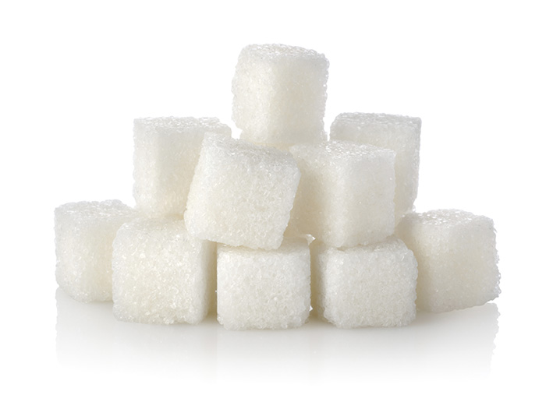
Riddle 4
Clean, but not water,
White, but not snow,
Sweet, but not an ice- cream,
What is it?

Slide 8
Proverbs and Idioms Match the English proverb with the Russian one
English
Russian
There’s no use crying over spilt milk.
Half a loaf is better than none.
Breakfast like a king, lunch like a queen and dine like a pauper.
I am as hungry as a hunter.
Я голоден как волк.
Завтрак съешь сам, обед раздели с другом, ужин отдай врагу.
Лучше синица в руках, чем журавль в небе.
Слезами горю не поможешь.

Slide 9
Let’s Check
There’s no use crying over spilt milk. — Слезами горю не поможешь
Half a loaf is better than none. - Лучше синица в руках, чем журавль в небе.
Breakfast like a king, lunch like a queen and dine like a pauper. -Завтрак съешь сам, обед раздели с другом, ужин отдай врагу.
I am as hungry as a hunter. - Я голоден как волк.

Slide 10
Make up a dialogue “In a Café.”
Useful phrases:
This is the menu, please.
Are you ready to order?
Can I have …?/I’d like to have …
Anything else?
What will you drink?
Can you bring me the bill, please?
How much is it?/How much does it cost?
How will you pay?/How are you going to pay?
By card./In cash.

Slide 11
